Slide 1
Model Evaluation
Varol Kayhan, PhD

Slide 2
Recall: Two ML "tasks"
Regression tasks:
Predict the value of a CONTINUOUS value
Classification tasks:
Predict the value of a CATEGORICAL value

Slide 3

Evaluate the Model: Regression Task
Error = difference between actual and predicted value.
$Error=yi −\hat{y}i$
Actual value
Predicted value

Slide 4
Evaluate the Model: Regression Task
Example: (validation OR test set)
ID | Age | Salary | Account Balance | Predicted Account Balance | Error
1 | 25 | 20000 | 1000 | 2000 | -1000
2 | 26 | 30000 | 5000 | 1000 | 4000
3 | 25 | 40000 | 2000 | 2000 | 0
4 | 30 | 50000 | 5000 | 6000 | -1000
5 | 35 | 50000 | 10000 | 8000 | 2000
What to do with the error value?

Slide 5

Evaluate the Model: Regression Task
Root Mean Squared Error (RMSE):
$$RMSE=\sqrt{\frac{1}{m}\sum_{1}^{m}{{(yi −\hat{y}i)}^{2}}}$$
m is the number of observations

Slide 6

Evaluate the Model: Regression Task
Example: (validation OR test set)
ID | Age | Salary | Account Balance | Predicted Account Balance | Error | Squared Error
1 | 25 | 20000 | 1000 | 2000 | -1,000 | 1,000,000
2 | 26 | 30000 | 5000 | 1000 | 4000 | 16,000,000
3 | 25 | 40000 | 2000 | 2000 | 0 | 0
4 | 30 | 50000 | 5000 | 6000 | -1,000 | 1,000,000
5 | 35 | 50000 | 10000 | 8000 | 2,000 | 4,000,000
Total = 22,000,000
MSE = 22,000,000/5 = 4,400,000
RMSE = $\sqrt{4,400,000}=2,098$

Slide 7

Evaluate the Model: Regression Task
You don't always have to use RMSE
Mean Absolute Error (MAE):
$$MAE= \frac{1}{m}\sum_{1}^{m}{\left|yi −\hat{y}i\right|}$$
m is the number of observations

Slide 8
Evaluate the Model: Regression Task
Example: (validation OR test set)
ID | Age | Salary | Account Balance | Predicted Account Balance | Error | ABS Error
1 | 25 | 20000 | 1000 | 2000 | -1,000 | 1,000
2 | 26 | 30000 | 5000 | 1000 | 4000 | 4,000
3 | 25 | 40000 | 2000 | 2000 | 0 | 0
4 | 30 | 50000 | 5000 | 6000 | -1,000 | 1,000
5 | 35 | 50000 | 10000 | 8000 | 2,000 | 2,000
Total = 8,000
MAE = 8,000/5 = 1,600

Slide 9
Evaluate the Model: Regression Task
Both RMSE and MAE measure distance
i.e., how far off are you from actual values?
RMSE is more sensitive to outliers than MAE
RMSE gives more weight to large errors (takes square)

Slide 10
Evaluate the Model: Regression Task
Other metrics:
Mean squared error (MSE)
Mean absolute percentage error (MAPE)
Sum of squared errors (SSE)
In regression tasks: the lower the error metrics, the better

Slide 11
Evaluate the Model: Regression Task
Baseline in regression tasks: predict all values as the "mean" of actual
ID | Age | Salary | Account Balance | Predicted Account Balance | Error
1 | 25 | 20000 | 1000 | 4600 | -3600
2 | 26 | 30000 | 5000 | 4600 | 400
3 | 25 | 40000 | 2000 | 4600 | -2600
4 | 30 | 50000 | 5000 | 4600 | 400
5 | 35 | 50000 | 10000 | 4600 | 5400
Mean = 4600
RMSE = 3,137
Predicted values are the mean value
Model RMSE = 2,098

Slide 12
Model Evaluation: Classification

Slide 13
Evaluate the Model: Classification Task
Most important metric: Accuracy
Is there a perfect model (100% accuracy)?

Slide 14
Evaluate the Model: Classification Task
Example: (validation OR test set)
ID | Age | Salary | Delinquent | Predicted Delinquent
1 | 25 | 20000 | 1 | 1
2 | 26 | 30000 | 0 | 0
3 | 25 | 40000 | 0 | 1
4 | 30 | 50000 | 1 | 1
5 | 35 | 50000 | 0 | 1
What is the accuracy?
What is the baseline accuracy? (next slide)

Slide 15
Evaluate the Model: Classification Task
Baseline accuracy: predict all values as the majority class/category
ID | Age | Salary | Delinquent | Predicted Delinquent | Baseline
1 | 25 | 20000 | 1 | 1 | 0
2 | 26 | 30000 | 0 | 0 | 0
3 | 25 | 40000 | 0 | 1 | 0
4 | 30 | 50000 | 1 | 1 | 0
5 | 35 | 50000 | 0 | 1 | 0
Baseline accuracy = 60%
Predict as the “majority” class
“Majority” class = 0

Slide 16
Evaluate the Model: Classification Task
Classification (or Confusion) matrix:
Organizes correct and incorrect classifications.
 | Predicted Class
Actual Class | 1 | 0
1 | True positive | False negative
0 | False positive | True negative

Slide 17
Evaluate the Model: Classification Task
Example: (validation OR test set)
ID | Age | Salary | Delinquent | Predicted Delinquent
1 | 25 | 20000 | 1 | 1
2 | 26 | 30000 | 0 | 0
3 | 25 | 40000 | 0 | 1
4 | 30 | 50000 | 1 | 1
5 | 35 | 50000 | 0 | 1
 | Predicted
Actual | 1 | 0
1
0

Slide 18
Evaluate the Model: Classification Task
Other evaluation metrics:
Sensitivity (Recall)
Specificity
Precision
Receiver Operating Characteristic (ROC) Curve
Area Under the Curve (AUC)
(Lift Chart)
(Cumulative Gains Chart)

Slide 19
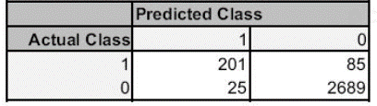

Evaluate the Model: Classification Task
Sensitivity (Recall): how sensitive is the model in predicting the positive cases
$$\frac{TP}{TP+FN}$$
$\frac{TP}{TP+FN}=\frac{201}{201+85}=$0.70
1 = Perfect recall
(the closer to 1, the better)
The model correctly predicts only 70% of the 1s.

Slide 20

Evaluate the Model: Classification Task
Specificity: Ability to predict negative cases (without false positives)
$$\frac{TN}{TN+FP}$$
$\frac{TN}{TN+FP}=\frac{2689}{2689+25}=$0.99
1 = Perfect specificity
(the closer to 1, the better)
The model correctly predicts 99% of the 0s.

Slide 21
Evaluate the Model: Classification Task
Sensitivity/specificity issue with Covid-19 (watch on your own)

Slide 22

Evaluate the Model: Classification Task
Precision: accuracy of positive predictions
$$\frac{TP}{TP+FP}$$
$\frac{TP}{TP+FP}=\frac{201}{201+25}=$0.89
1 = Perfect precision
(the closer to 1, the better)
When the model predicts a 1, it is correct only 89% of the time.

Slide 23
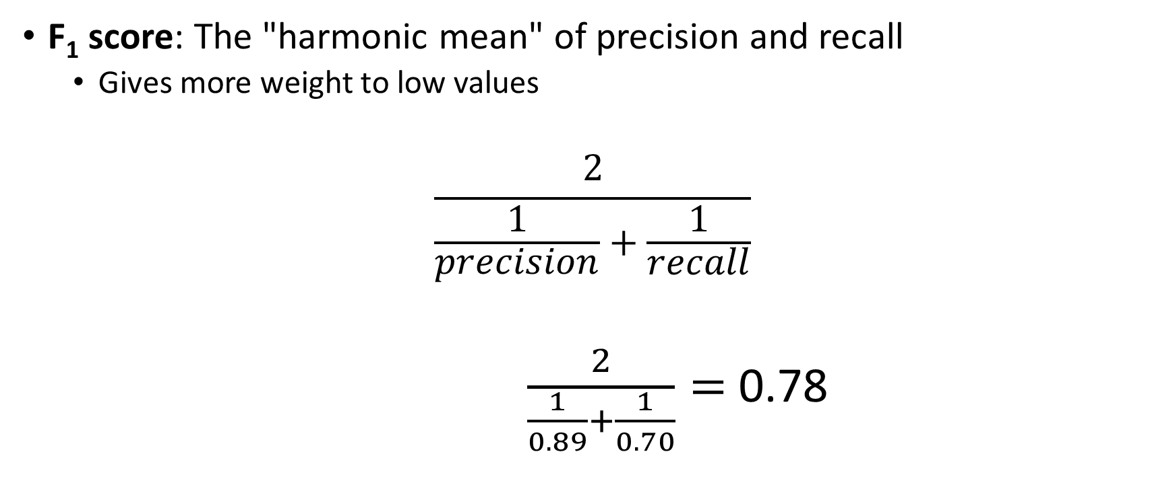
Evaluate the Model: Classification Task
F₁ score: The "harmonic mean" of precision and recall
Gives more weight to low values
$$\frac{2}{\frac{1}{precision}+\frac{1}{recall}}$$
$\frac{2}{\frac{1}{0.89}+\frac{1}{0.70}}=$ 0.78
1 = Perfect score
(the closer to 1, the better)

Slide 24
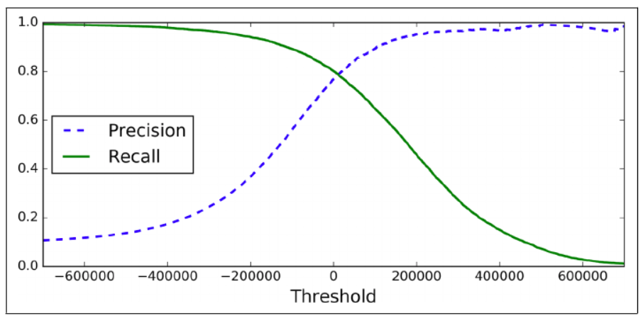
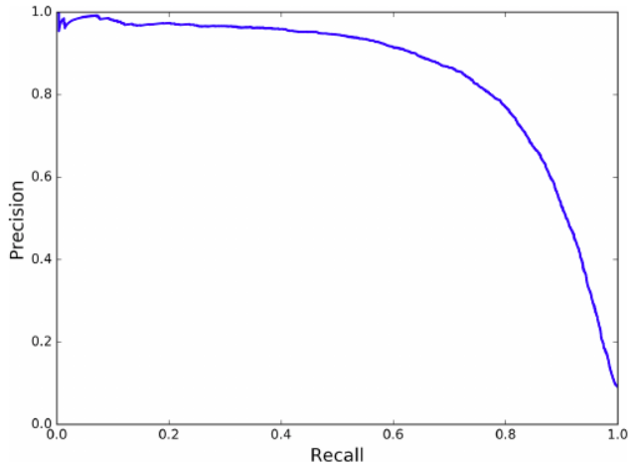
Evaluate the Model: Classification Task
Precision/Recall Tradeoff: Can't have it both ways
Increasing precision reduces recall (and vice versa)

Slide 25
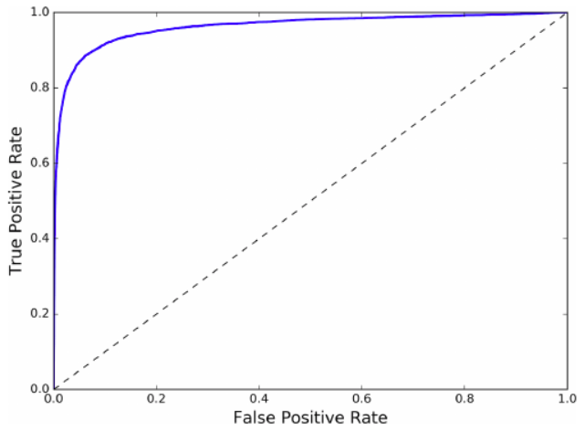
Evaluate the Model: Classification Task
ROC Curve: Receiver Operating Characteristics curve
True positive rate vs. false positive rate (Sensitivity vs. (1-specificity))
AUC: Area under the curve
If AUC = 1, it is a perfect model

Slide 26
Evaluate the Model: Classification Task
Error Analysis: Examine the confusion matrix to see where errors are made

Slide 27
Underfitting & Overfitting
ALWAYS compare train and test values WITHIN and BETWEEN models
Example: predict loan default (baseline = 55%)
Model 1 results:
Train accuracy = 90%
Test accuracy = 70%
Model 2 results:
Train accuracy = 60%
Test accuracy 59%

